Slide 1
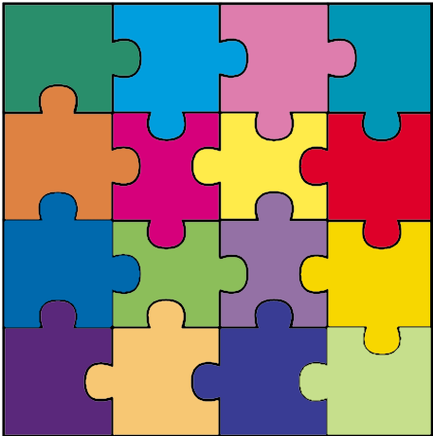
The Myers-Briggs Typology Indicator
ISTJ
ISFJ
INFJ
INTJ
“Take your time and do it right”
“On my honor, to do my duty…”
“Catalyst for positive change”
“Competence + Independenct = Perfection”
ISTP
ISFP
INFP
INTP
“Doing the best I can with what I’ve got”
“It’s the thought that counts”
“Still waters run deep”
“Ingenious problem solvers”
ESTP
ESFP
ENFP
ENTP
“Let’s get busy!”
“Don’t worry, Be Happy”
“Anything’s possible”
“Life’s Entrepreneurs”
ESTJ
ESFJ
ENFJ
ENTJ
“Taking care of business”
“What can I do for you?”
“The public relations specialist”
“Everything’s fine – I’m in charge”

Slide 2
What is the Myers-Briggs Typology Indicator?
An instrument to make Carl Jungs’ theories accessible and usable in everyday life.
It is currently the most widely used personality preference instrument in the world.
A tool that reflects an individual’s preferences, but does NOT measure abilities, likelihood for success, intelligence, skills, maturity, or mental health.
A tool for helping people understand each other’s differences.

Slide 3
Constructive Use of Differences
Isabel Myer’s goal for type and the MBTI® instrument:
Becoming aware of differences
Acknowledging the value of differences
Practicing new behaviors, seeking out others with differences
Incorporating different perspectives into our own processes

Slide 4
Type Preference
Type describes innate preferences – we all have access to both aspects of type, we just have a preference for using a particular one
The preferred type has been strengthened by use
We all use both preferences, but usually not with equal comfort

Slide 5
INTROVERSION
OR
EXTRAVERSION

Slide 6
Favorite world: Do you prefer to focus on your own inner world or on the outer world? This is called Introversion (I) or Extraversion (E).

Slide 7
People who prefer Introversion
Are attracted to the inner world of thoughts, feelings, and reflections
Are usually very aware of their inner reactions
Prefer to interact with people they know
Are often quiet in meetings and seem uninvolved
Are often reserved and harder to get to know
May not be as aware of the outer world around them

Slide 8
People who prefer Extraversion
Are attracted to the outer world of people and events
Are aware of who and what is around them
Enjoy meeting and talking with new people
Are friendly, often verbally skilled, and easy to know
Tend to speak out easily and often at meetings
May not be as aware of what is going on inside themselves

Slide 9
Good I/E Words
Introverts (I) vs. Extraverts (E)
Introverts
Territorial
Concentration
Internal
Depth
Intensive
Limited relationships
Cautious disclosure
Contained
Internal reactions
Reflective
Thinks to speak
Extraverts
Social
Interaction
External
Breadth
Extensive
Multiple relationships
Free disclosure
Expressive
External events
Gregarious
Speaks to think

Slide 10
Self-Assessment
Given the choice, which do you prefer:
Introversion or Extraversion?
How clear are you about your preference?
?
I
E
?
Very
Clear
Fairly
Clear
Fairly
Clear
Very
Clear
Slight
Slight

Slide 11
Any question on I and E?
ISTJ
ISFJ
INFJ
INTJ
“Take your time and do it right”
“On my honor, to do my duty…”
“Catalyst for positive change”
“Competence + Independenct = Perfection”
ISTP
ISFP
INFP
INTP
“Doing the best I can with what I’ve got”
“It’s the thought that counts”
“Still waters run deep”
“Ingenious problem solvers”
ESTP
ESFP
ENFP
ENTP
“Let’s get busy!”
“Don’t worry, Be Happy”
“Anything’s possible”
“Life’s Entrepreneurs”
ESTJ
ESFJ
ENFJ
ENTJ
“Taking care of business”
“What can I do for you?”
“The public relations specialist”
“Everything’s fine – I’m in charge”

Slide 12
Sensing
OR
Intuition

Slide 13
Information: Do you prefer to focus on the basic information you take in or do you prefer to interpret and add meaning? This is called Sensing (S) or Intuition (N).

Slide 14
People who prefer Sensing
See and collect facts and details
Are practical and realistic
Start at the beginning and take one step at a time
Are specific and literal when speaking, writing, and listening
Live in the present, dealing with the here and now
Prefer reality to fantasy

Slide 15
People who prefer Intuition
See patterns, possibilities, connections, and meanings in information
Are conceptual and abstract
Start anywhere and may leap over basic steps
Speak and write in general, metaphorical terms
Live in the future – the possibilities
Prefer imagination and ingenuity to reality

Slide 16
Good S/N Words
Sensors (S) vs. iNtuitives (N)
Sensors
Literal
Present
Tangible
Perspiration
Actual
Down-to-earth
Fact
Practicality
Specific
iNtuitives
Random
Future
Conceptual
Inspirational
Theoretical
Head-in-the-clouds
Fantasy
Ingenuity
General

Slide 17
Self-Assessment
Given the choice, which do you prefer:
Sensing or Intuition?
How clear are you about your preference?
?
S
N
?
Very
Clear
Fairly
Clear
Fairly
Clear
Very
Clear
Slight
Slight

Slide 18
Any question on S and N?
ISTJ
ISFJ
INFJ
INTJ
“Take your time and do it right”
“On my honor, to do my duty…”
“Catalyst for positive change”
“Competence + Independenct = Perfection”
ISTP
ISFP
INFP
INTP
“Doing the best I can with what I’ve got”
“It’s the thought that counts”
“Still waters run deep”
“Ingenious problem solvers”
ESTP
ESFP
ENFP
ENTP
“Let’s get busy!”
“Don’t worry, Be Happy”
“Anything’s possible”
“Life’s Entrepreneurs”
ESTJ
ESFJ
ENFJ
ENTJ
“Taking care of business”
“What can I do for you?”
“The public relations specialist”
“Everything’s fine – I’m in charge”

Slide 19
Thinking
OR
Feeling

Slide 20
Decisions: When making decisions, do you prefer to first look at logic and consistency or first look at the people and special circumstances? This is called Thinking (T) or Feeling (F).

Slide 21
People who prefer Thinking
Use logic to analyze the problem, assess pros and cons
Focus on the facts and the principles
Are good at analyzing a situation
Focus on problems and tasks – not relationships
May not include the impacts on people or people’s emotions in their decision making

Slide 22
People who prefer Feeling
Use their personal values to understand the situation
Focus on the values of the group or organization
Are good at understanding people and their viewpoints
Concentrate on relationships and harmony
May overlook logical consequences of individual decisions

Slide 23
Good T/F Words
Thinkers (T) vs. Feelers (F)
Thinkers
Non-personal
Objective
Principles
Laws
Firmness
Just
Clarity
Critique
Policy
Detached
Head
Feelers
Interpersonal
Subjective
Principals
Circumstances
Persuasion
Humane
Harmony
Appreciate
Social Values
Involved
Heart

Slide 24
Self-Assessment
Given the choice, which do you prefer:
Thinking or Feeling?
How clear are you about your preference?
?
T
F
?
Very
Clear
Fairly
Clear
Fairly
Clear
Very
Clear
Slight
Slight

Slide 25
Any question on T and F?
ISTJ
ISFJ
INFJ
INTJ
“Take your time and do it right”
“On my honor, to do my duty…”
“Catalyst for positive change”
“Competence + Independenct = Perfection”
ISTP
ISFP
INFP
INTP
“Doing the best I can with what I’ve got”
“It’s the thought that counts”
“Still waters run deep”
“Ingenious problem solvers”
ESTP
ESFP
ENFP
ENTP
“Let’s get busy!”
“Don’t worry, Be Happy”
“Anything’s possible”
“Life’s Entrepreneurs”
ESTJ
ESFJ
ENFJ
ENTJ
“Taking care of business”
“What can I do for you?”
“The public relations specialist”
“Everything’s fine – I’m in charge”

Slide 26
Judging
OR
Perceiving

Slide 27
Structure: In dealing with the outside world, do you prefer to get things decided or do you prefer to stay open to new information and options? This is called Judging (J) or Perceiving (P).

Slide 28
People who prefer Judging
Like to make plans and follow them
Like to get things settled and finished
Like environments with structure and clear limits
Enjoy being decisive and organizing others
Handle deadlines and time limits comfortably
Plan ahead to avoid last minute rushes

Slide 29
People who prefer Perceiving
Like to respond resourcefully to changing situations
Like to leave things open, gather more information
Like environments that are flexible; dislike rules and limits
May not like making decisions, even when pressed
Tend to think there is plenty of time to do things
Often have to rush to complete things at the last minute

Slide 30
Good J/P Words
Judgers (J) vs. Perceivers (P)
Judgers
Resolved
Decided
Fixed
Control
Closure
Planned
Structure
Definite
Scheduled
Product
Perceivers
Pending
Wait and See
Flexible
Adapt
Openness
Open-ended
Alternatives
Tentative
Spontaneous
Process

Slide 31
Self-Assessment
Given the choice, which do you prefer:
Judging or Perceiving?
How clear are you about your preference?
?
J
P
?
Very
Clear
Fairly
Clear
Fairly
Clear
Very
Clear
Slight
Slight

Slide 32
Any question on J and P?
ISTJ
ISFJ
INFJ
INTJ
“Take your time and do it right”
“On my honor, to do my duty…”
“Catalyst for positive change”
“Competence + Independenct = Perfection”
ISTP
ISFP
INFP
INTP
“Doing the best I can with what I’ve got”
“It’s the thought that counts”
“Still waters run deep”
“Ingenious problem solvers”
ESTP
ESFP
ENFP
ENTP
“Let’s get busy!”
“Don’t worry, Be Happy”
“Anything’s possible”
“Life’s Entrepreneurs”
ESTJ
ESFJ
ENFJ
ENTJ
“Taking care of business”
“What can I do for you?”
“The public relations specialist”
“Everything’s Fine – I’m in charge”

Slide 33
Personality Type
When combined, your preferences indicate your personality type.
I
I
or
E
S
or
N
T
or
F
J
or
P

Slide 34
16 Personality Types
ISTJ
ISFJ
INFJ
INTJ
“Take your time and do it right”
“On my honor, to do my duty…”
“Catalyst for positive change”
“Competence + Independenct = Perfection”
ISTP
ISFP
INFP
INTP
“Doing the best I can with what I’ve got”
“It’s the thought that counts”
“Still waters run deep”
“Ingenious problem solvers”
ESTP
ESFP
ENFP
ENTP
“Let’s get busy!”
“Don’t worry, Be Happy”
“Anything’s possible”
“Life’s Entrepreneurs”
ESTJ
ESFJ
ENFJ
ENTJ
“Taking care of business”
“What can I do for you?”
“The public relations specialist”
“Everything’s fine – I’m in charge”

Slide 35
Estimated Frequencies
Frequencies of the types in the United States Population
Total
ISTJ
11-14%
ISFJ
9-14%
INFJ
1-3%
INTJ
2-4%
I
47-55%
E
45-53%
ISTP
4-6%
ISFP
5-9%
INFP
4-5%
INTP
3-5%
S
66-74%
N
26-34%
ESTP
4-5%
ESFP
4-9%
ENFP
6-8%
ENTP
2-5%
T
40-50%
F
50-60%
J
54-60%
P
40-46%
ESTJ
8-12%
ESFJ
9-13%
ENFJ
2-5%
ENTJ
2-5%
Center for Applications of Psychological Type, Inc.

Slide 36
Estimated Frequencies
Frequencies of the types in the United States Population
Females
ISTJ
7-10%
ISFJ
15-20%
INFJ
2-4%
INTJ
1-3%
I
45-55%
E
45-55%
ISTP
2-3%
ISFP
6-10%
INFP
4-7%
INTP
1-3%
S
70-75%
N
25-30%
ESTP
2-4%
ESFP
7-10%
ENFP
8-10%
ENTP
2-4%
T
24-35%
F
65-76%
J
55-60%
P
40-45%
ESTJ
6-8%
ESFJ
12-17%
ENFJ
3-6%
ENTJ
1-4%
Center for Applications of Psychological Type, Inc.

Slide 37
Estimated Frequencies
Frequencies of the types in the United States Population
Males
ISTJ
14-19%
ISFJ
6-8%
INFJ
1-2%
INTJ
2-6%
I
50-55%
E
45-50%
ISTP
6-9%
ISFP
4-8%
INFP
3-5%
INTP
4-7%
S
65-72%
N
28-35%
ESTP
5-6%
ESFP
3-7%
ENFP
5-7%
ENTP
3-7%
T
55-67%
F
33-45%
J
52-58%
P
42-48%
ESTJ
10-12%
ESFJ
5-8%
ENFJ
1-3%
ENTJ
3-6%
Center for Applications of Psychological Type, Inc.

Slide 38
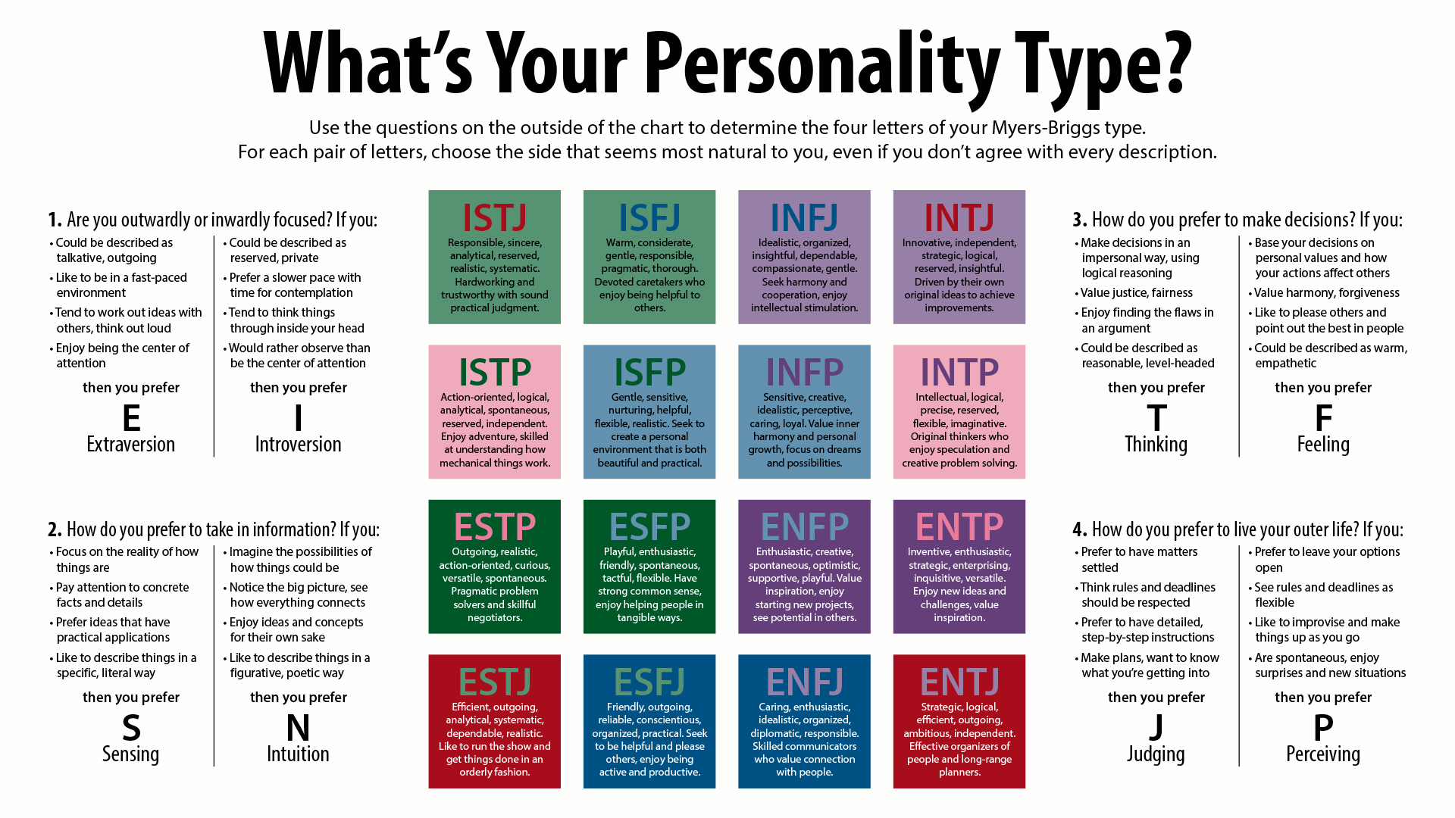
MyersBriggsTypes CC BY-SA 3.0
Jake Beech - Own work

Slide 39

Take the test
Jung Typology Test™
http://www.humanmetrics.com/

Slide 40
Introverts communicating with Extraverts should:
Focus on actions to be taken
Focus on results
Communicate verbally with enthusiasm
Emphasize action over deliberation

Slide 41
Extraverts communicating with Introverts should:
Communicate a well-thought-through idea or plan
Build in time for Introverts to reflect before deciding
Communicate in written form rather than orally
Allow airtime for Introverts who wait for silence to speak

Slide 42
Sensors communicating with Intuitives should:
Start with an overarching description of the issue or challenge rather than the relevant details
Allow room for creative exploration before moving to facts
Describe the overall goal and strategies before moving to tactics
Explain the desired outcomes and related challenges of a project

Slide 43
Intuitives communicating with Sensors should:
Clearly identify the problem they are trying to solve
Share relevant facts and details
Reduce risk factors or required changes
Describe successful applications of the desired strategies

Slide 44
Thinkers communicating with Feelers should:
Be descriptive rather than judgmental
Use empathy by imagining the other’s perspective
Start with a concern for what is important to people
Consider a decision’s impact on the people who carry it out
Start with the positives rather than the negatives

Slide 45
Feelers communicating with Thinkers should:
Discuss the costs and benefits of the issues
Identify the issue clearly, the principles involved, and potential solutions, as well as their strengths and weaknesses
Take a stand and make their case succinctly
Be willing to engage in debate without taking it personally

Slide 46
Judgers communicating with Perceivers should:
Allow Perceivers flexibility around “how” they meet their goals
Allow sufficient time for brainstorming
Realize there are often far more “right” solutions than their own
Consider multiple options before pressing for closure
Understand that over-directing Perceivers will lead to their resistance

Slide 47
Perceivers communicating with Judgers should:
Understand that frequent or last-minute changes adversely affect Judgers
Take Judgers’ deadlines seriously and “to the minute”
Balance brainstorming with analysis and decision-making
Reopen decisions only when new data significantly impacts the decision
Take a clear stand

Slide 48
?

Slide 49
References
Krikau, Paul. “The Myers-Briggs Typology Indicator”
The Myers & Briggs Foundation. “MBTI Basics”
Berney, Liz. “Using the Myers-Briggs Type Indicator to Enhance Workplace Communication”

